Slide 1
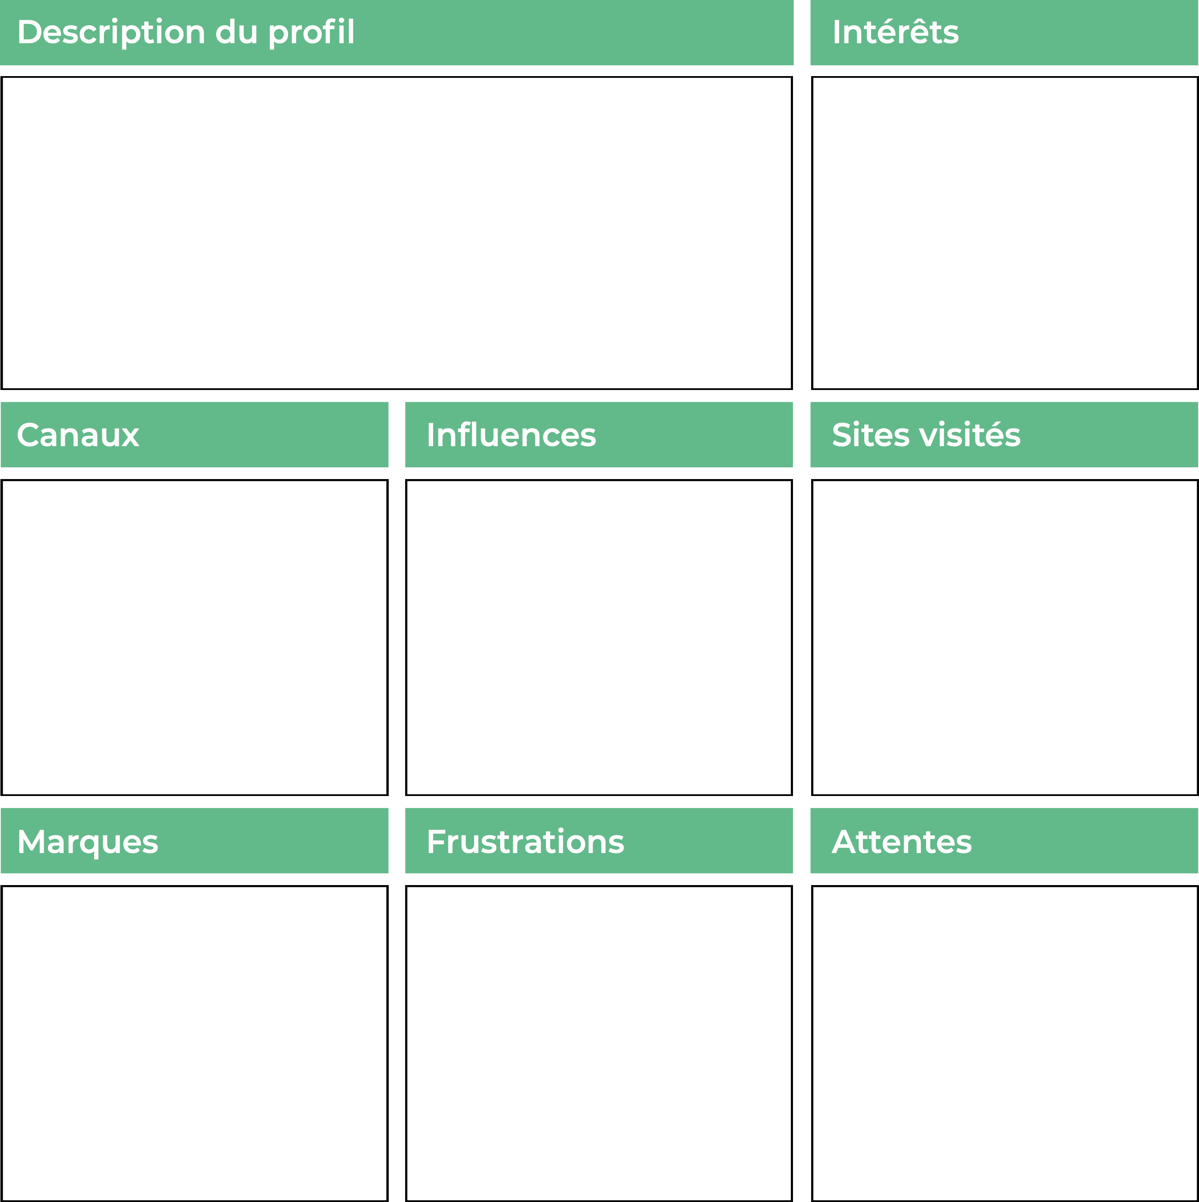
Personae 1
Nom
Age
Job
Education
Localisation
Status
Revenus

